Slide 1


Design Review Case Study - Atlis Biosystem's RepliGut
Sebastien Augustin• 11.06.2022

Slide 2
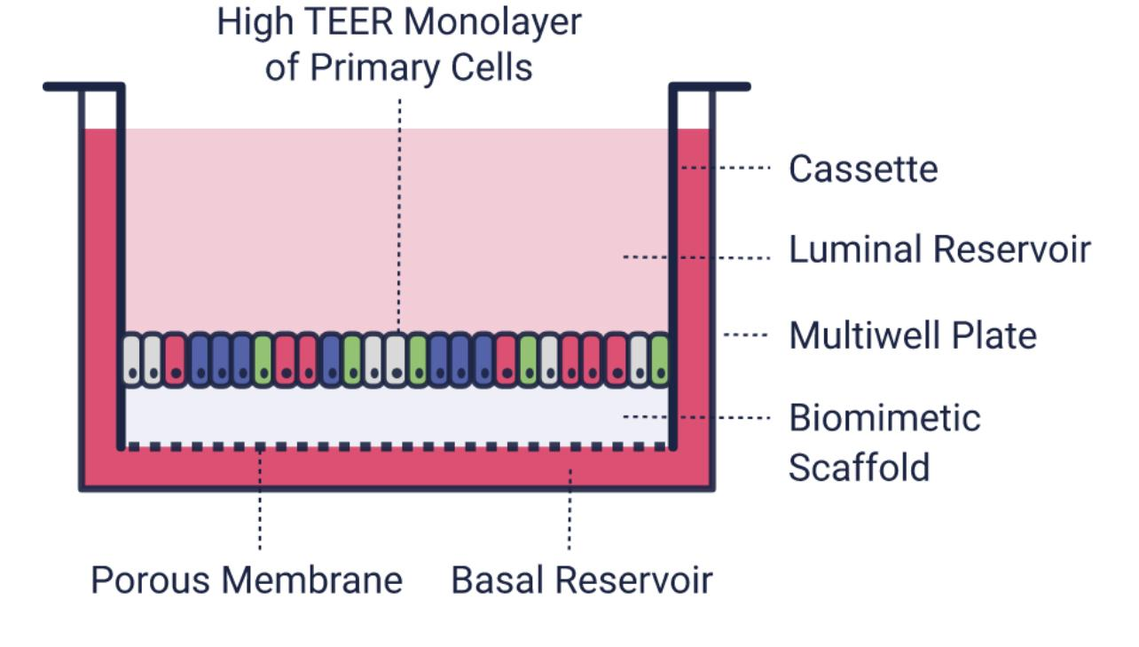

Problem Description
Within the current research environments of current invitro and in vivo models used in the development of therapies/treatments for intestinal diseases, researchers have come across severe limitations
In response to these limitations, RepliGut was made. RepliGut is a "unique, stem cell-derived platform that recreates the human small intestine and colonic epithelium for more biologically relevant screening of compounds, disease modeling, and microbiome research."

Slide 3
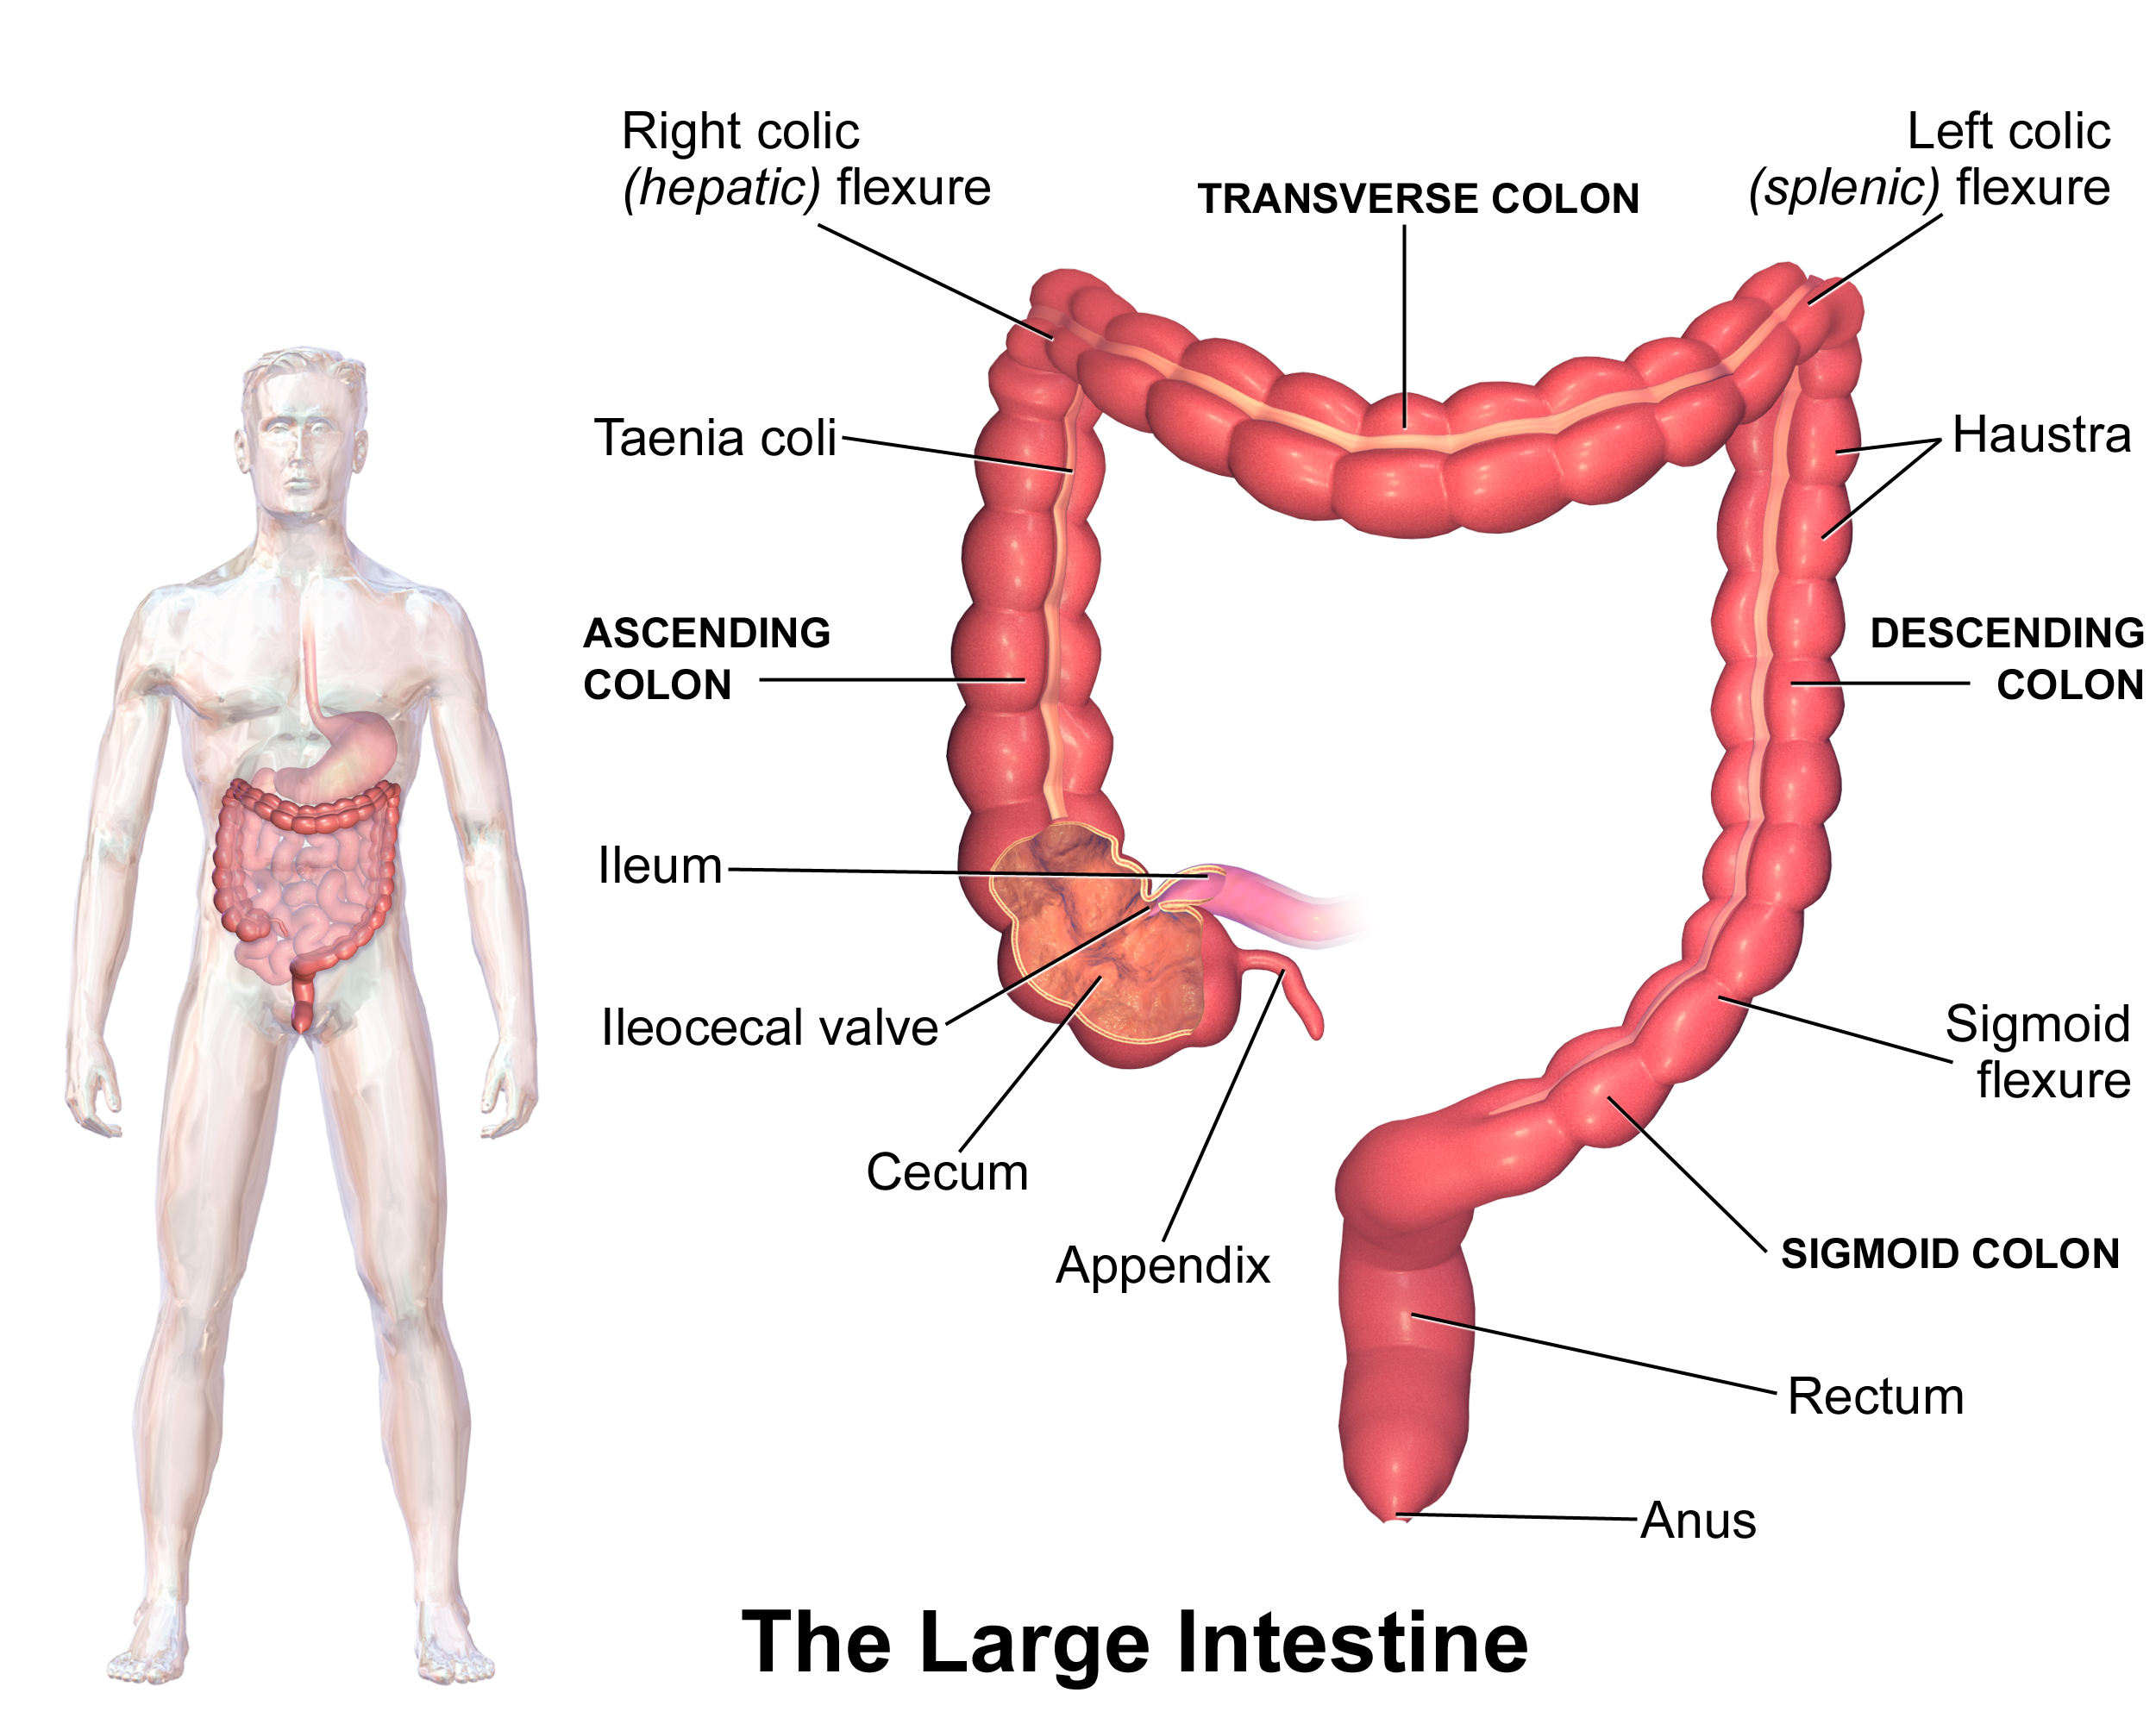

Background/ Motivation
RepliGut aims to solve a series of challenges that researchers of the human G.I. tracts face and the diseases that affect them.
These challenges include the G.I. tract being the organ with the most adverse drug reactions and. rodents showing a low concordance with most, if not all, human clinical outcomes.
Additionally, there needs to be more predictable in vitro models and a significant lack of human models capable of G.I. risk assessment usable for drug optimization in their early developments, among other things.

Slide 4
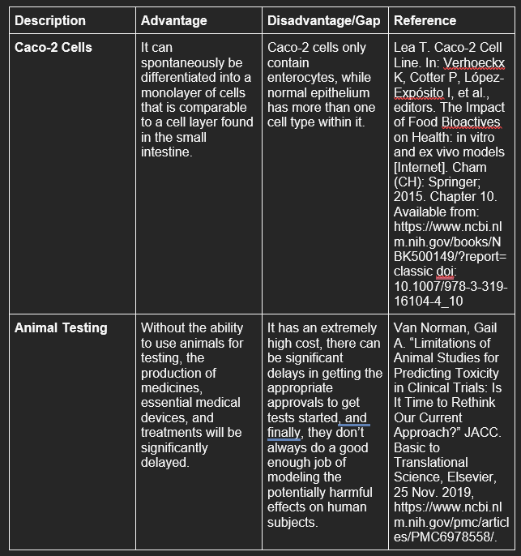

RepliGut Solution Landscape
Ac

Slide 5
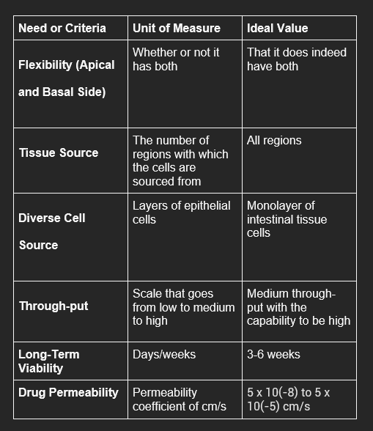

Solutions, Advantages, and Gaps

Slide 6


Verification and Validation
Regarding the verification studies, RepliGut, while still quite new in its inception, was able to create “tissue constructs [that] are polarized monolayers that express tight junction proteins and can be tailored to include stem/progenitor cells, differentiated cells, or both, representing all major cell lineages in physiologic ratios.” [1]
Regarding the validation studies of RepliGut, it is currently being used in settings for one-time analyses. As a result, it has yet to be a tool widely utilized in preclinical client screenings. RepliGut’s company, Atlis Biosystems, is actively working towards making this a reality.

Slide 7

Conclusion

Slide 8

Atlis Biosystem’s Repligut is an innovative technology that doesn’t necessarily have a large amount of publicly available research available. Despite this fact, as a breakthrough technology, it's breaking ground in many respects. From its versatility in use and function to research collaborations with biopharmaceutical giants like AstraZeneca, it’s paving new roads whilst also learning from established giants.

Slide 9
References
Allbritton, Nancy. “Accelerating Drug Development with Microphysiological Systems (MPS).” Home, Pharma's Almanac, 29 Sept. 2020, https://www.altisbiosystems.com/resources/accelerating-drug-development-with-microphysiological-systems-mps.
“Artificial Organ and Bionics Market Size &amp; Share Report, 2030.” Artificial Organ And Bionics Market Size &amp; Share Report, 2030, https://www.grandviewresearch.com/industry-analysis/artificial-organ-and-bionics
"Altis Biosystems Offers Research Award for Use of Its RepliGut Platform." NC Biotech, https://www.ncbiotech.org/news/altis-biosystems-offers-research-award-use-its-repligut-platform.
Bailey Zwarycz, Ph.D. "The Power of RepliGut in Vitro Intestinal Stem Cell Models." Pharma's Almanac: Nice Insight's Content Community,
Biosystems, Altis. Home, https://www.altisbiosystems.com/.
"Platform." Home, https://www.altisbiosystems.com/platform?utm_term=organ+on+a+chip&amp;utm_campaign=non-branded&amp;utm_source=adwords&amp;utm_medium=ppc&amp;hsa_acc=4546521797&amp;hsa_cam=16439724699&amp;hsa_grp=138171654174&amp;hsa_ad=613426201158&amp;hsa_src=g&amp;hsa_tgt=kwd-507299853592&amp;hsa_kw=organ+on+a+chip&amp;hsa_mt=p&amp;hsa_net=adwords&amp;hsa_ver=3&amp;gclid=CjwKCAjwwL6aBhBlEiwADycBIOEF9mtsq8LNyfrE8j-qprk-4rrZJbBO11V53KgBVymUhFsBt6IhCBoCOdUQAvD_BwE.
Laethem, Ron. “Developing a Robust in Vitro Intestinal Model for Preclinical Candidate Screening of GI Toxicity.” Home, 12 Apr. 2021, https://www.altisbiosystems.com/resources/developing-a-robust-in-vitro-intestinal-model-for-preclinical-candidate-screening-of-gi-toxicity.
Lea T. Caco-2 Cell Line. In: Verhoeckx K, Cotter P, López-Expósito I, et al., editors. The Impact of Food Bioactives on Health: in vitro and ex vivo models [Internet]. Cham (CH): Springer; 2015. Chapter 10. Available from: https://www.ncbi.nlm.nih.gov/books/NBK500149/?report=classic doi: 10.1007/978-3-319-16104-4_10
Lemmens, Glenn, et al. "Drug Disposition in the Lower Gastrointestinal Tract: Targeting and Monitoring." Pharmaceutics, vol. 13, no. 2, 2021, https://doi.org/10.3390/pharmaceutics13020161. Accessed 6 Dec. 2022.
Magness, Ph.D, Scott. “Evaluating Microbiome Therapies with Intestinal Cell Models.” Pharma's Almanac, 22 Oct. 2020, https://www.altisbiosystems.com/resources/evaluating-microbiome-therapies-with-intestinal-cell-models.
“Study Shows Global Prevalence of Functional Gastrointestinal Disorders.” Edited by Emily Henderson, News, 27 May 2020, https://www.news-medical.net/news/20200527/Study-shows-global-prevalence-of-functional-gastrointestinal-disorders.aspx#:~:text=For%20every%20ten%20adults%20in,those%20now%20presenting%20these%20results.
Sun H, Chow EC, Liu S, Du Y, Pang KS. The Caco-2 cell monolayer: usefulness and limitations. Expert Opin Drug Metab Toxicol. 2008 Apr;4(4):395-411. doi: 10.1517/17425255.4.4.395. PMID: 18433344.
Thelin, Bill. “A Novel, High-Throughput Platform to Characterize Novel Ibd Therapeutics.” Home, 16 Feb. 2022, https://www.altisbiosystems.com/resources/developing-a-robust-in-vitro-intestinal-model-for-preclinical-candidate-screening-of-gi-toxicity-0-0.
Trietsch, Sebastiaan J., et al. “Membrane-Free Culture and Real-Time Barrier Integrity Assessment of Perfused Intestinal Epithelium Tubes.” Nature News, Nature Publishing Group, 15 Aug. 2017, https://www.nature.com/articles/s41467-017-00259-3
Van Norman, Gail A. “Limitations of Animal Studies for Predicting Toxicity in Clinical Trials: Is It Time to Rethink Our Current Approach?” JACC. Basic to Translational Science, Elsevier, 25 Nov. 2019, https://www.ncbi.nlm.nih.gov/pmc/articles/PMC6978558/.
Wang Y, DiSalvo M, Gunasekara DB, Dutton J, Proctor A, Lebhar MS, Williamson IA, Speer J, Howard RL, Smiddy NM, Bultman SJ, Sims CE, Magness ST, Allbritton NL. Self-renewing Monolayer of Primary Colonic or Rectal Epithelial Cells. Cell Mol Gastroenterol Hepatol. 2017 Mar 6;4(1):165-182.e7. doi: 10.1016/j.jcmgh.2017.02.011. PMID: 29204504; PMCID: PMC5710741.
Zwarycz, Ph.D, Bailey. “The Power of RepliGut® in Vitro Intestinal Stem Cell Models.” AtlisBiosystems, 5 Aug. 2021, https://www.altisbiosystems.com/resources/developing-a-robust-in-vitro-intestinal-model-for-preclinical-candidate-screening-of-gi-toxicity-0.

Slide 10

Thank You!

